Slide 1
Report of the FIG/IHO/ICA IBSC to the IHO IRCC11
www.iho.int/ibsc

Slide 2
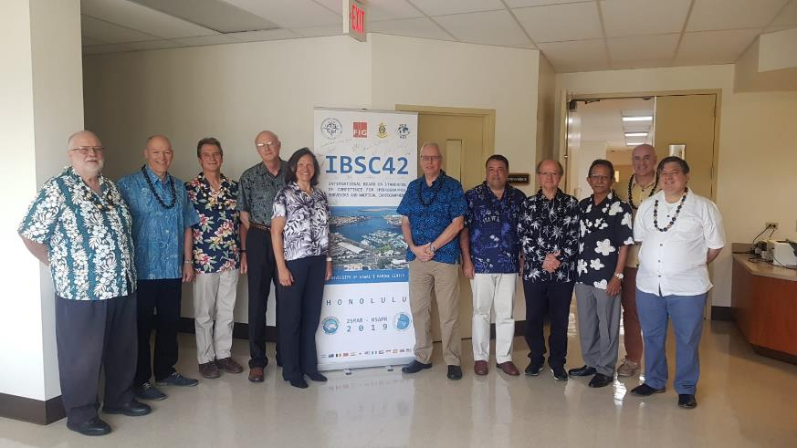
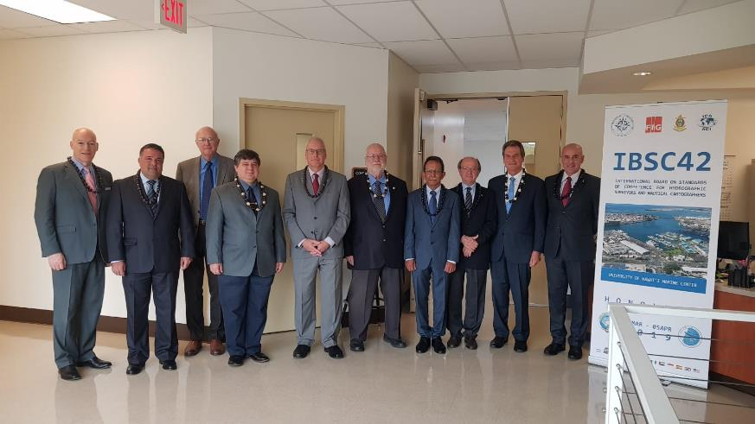
The Board
10 Board members: 4 FIG, 4 IHO, 2 ICA
(+IHO Secretariat)
Notes:
Capt. Leonel Pereira Manteigas, Portugal (IHO), has been appointed to the Board effective 1st September 2018

Slide 3
The Role of the Board
Review syllabi of programmes and individual recognition schemes from education and training institutions
Maintain IBSC publications;
Provide guidance to education and training institutions;
Support the IHO for the establishment of new hydrographic programmes where regional training capacity does not exist;
Review the procedures of submission.

Slide 4
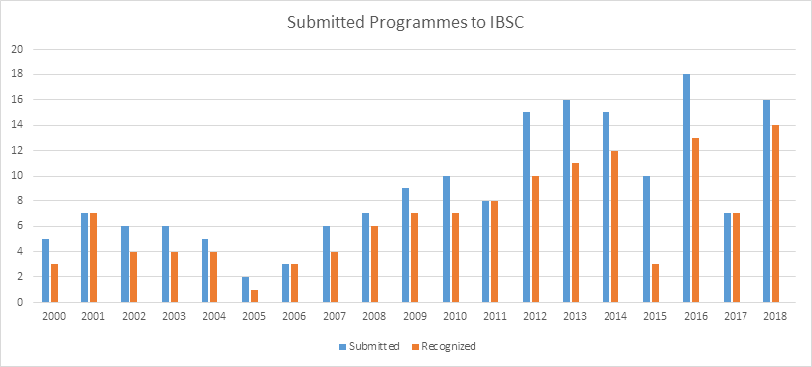
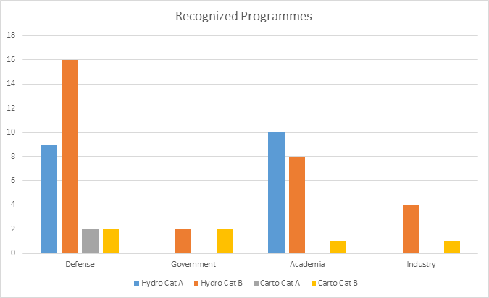
Recognised Programmes
Total 60+ recognized programmes & 2 recognized schemes

Slide 5
Work Program 2018-2019
The IBSC has been working on the following tasks :
Implementation of the Right First Time principle, i.e. assisting institutions improve the quality of submissions; (IBSC Work Plan Q2 2018 to Q2 2019, approved IRCC10, Decision 26) and,
Review the IBSC standards and maintain IBSC Publications (Task 3.8.4, IHO 3 year Work Programme 2018-2020)
IBSC Workshop - MPA, Singapore (5-9 Nov 2018)
IBSC42 - University of Hawaii Marine Center, USA (25 Mar-5 Apr 2019)

Slide 6
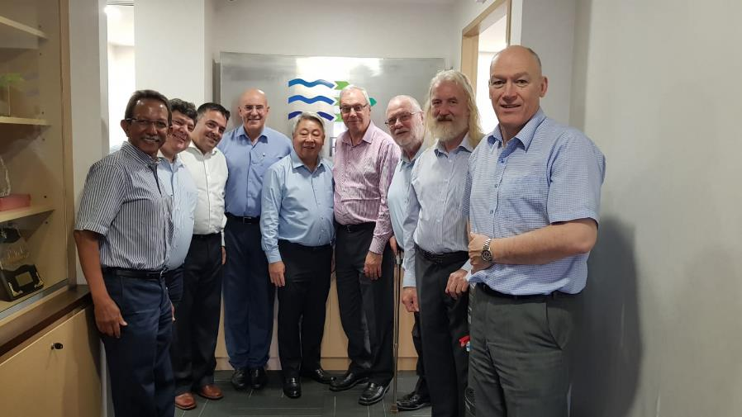
IBSC Workshop - MPA, Singapore (5-9 Nov 2018)
Intersessional reviews, Guidelines and FAQs

Slide 7
New Standards Framework Published
Following decisions made at IRCC10 the following standards and guidelines were published in 2018:
Standard | Ed
S-5A Standards of Competence for Category "A" Hydrographic Surveyors | Ed. 1.0.2, June 2018
S-8A Standards of Competence for Category "A" Nautical Cartographers | Ed. 1.0.1, June 2018
Guidelines for the Implementation of the Standards of Competence for Hydrographic Surveyors and Nautical Cartographers | Ed 2.1.0, May 2019
This extensive update to the Guidelines includes:
- Section 6. Professional Certification or Recognition Schemes clarified
- Section 7.1 a single PDF digital submission only
- Section 7.1.3 Inserted an example of a Module Schedule Table
- Section 7.1.3 Requirement for a Timeline of the programme
- Section 7.2.3. Inserted an example of the Practical Exercises Table
- Section 8.1 & 8.2. Clarified IBSC review and Evaluation Process
- Section 9.3 & 9.4. Requirements for Annual Report modified
- Annex A. Checklist and flow diagrams modified

Slide 8
IBSC42 Meeting 25 Mar-5 April 2019
Annual meeting - 10 days
Hosted by University of Hawaii Marine Center, Honolulu, USA
16 Submissions from 12 countries (12 Hydro, 3 Carto & 1 Scheme)
3xChina, 3xIndia, Malaysia, USA, UK, Argentina, Australia, Japan, Nigeria, Saudi Arabia, Spain & Singapore
3 submissions per day, 13 delegations, 13 presentations

Slide 9
IBSC42 Submissions
Sixteen (16) submissions were reviewed against the new standards.
Status | N. | Standards of Competence
Recognized | 2 | 2 x Hydro S-5B
Recognized with Conditions | 9 | 1 x Hydro S-5A 4 x Hydro S-5B 2 x Carto S-8A 1 x Carto S-8B 1 x Scheme S-5 (A&B)
Not recognized | 5 | 2 x Hydro S-5A 3 x Hydro S-5B
Total | 16
4 new programmes submitted
11 programmes recognized

Slide 10
Challenges:
Quality of submissions
The new standards framework implementation is a major undertaking and requires a step change in the preparation of programmes and submissions to match the improved standards
Recognized with conditions / Not Recognized
Right First Time principle - all programmes are Recognized at the first review stage
Managing workload
Large number of submissions
Recognition period 6 yrs
New programmes and schemes
Stakeholder engagement & outreach
Promoting the work of the IBSC and Standards
Guidance and assistance to institutions

Slide 11
Proposed Work Plan
ANNEX B
Task | Work Item | Priority | Milestones | Start Date | End Date | Status | Contact Person | Affected Pubs/Standard | Remarks
1 | Review of IBSC42 Conditional Recognition submissions | H |  | Q2-Q3 2019 |  | O | Board Members |  | Intersessional
2 | Publish FAQ Right First Time companion document | H | IBSC43 | Q3 2019 | Q1 2020 | P | Chair | New | Workshop / virtual WG to complete this task
3 | On-site visits to provide guidance and assistance to institutions | M |  | Q3-Q4 2019 |  | P | Board Members |  | China, , Indonesia-Navy, Belgium
4 | Stakeholder engagement – workshops, presentations | M |  | 2019-20 |  | P | Board Members |  | Oceans19, ICC 2019 IHO/NF Alumni Seminar (Singapore), IHO A-2
5 | IBSC43 | M |  | 2020 |  | P | IHO Secretariat |  | Colombia, March 2020

Slide 12
The IRCC is invited to:
Note this report;
Acknowledge the work done by the Board in the delivery of the new companion document Guidelines for the Implementation of the Standards of Competence for Hydrographic Surveyors and Nautical Cartographers Ed. 2.1.0 (May 2019)
Encourage Member States and submitting institutions to engage with the IHO Secretariat early on in the process of preparing submissions for programme recognition

Slide 13
The IRCC is invited to:
Encourage Member States and submitting institutions to consult the Guidelines and the white paper (IHR-Nov-2017 - Article Maintaining the Standards of Competence for Hydrographic Surveyors and Nautical Cartographers) early on in the process of preparing submissions for programme recognition
Agree the IBSC Proposed Work Plan – Q2 2019 to Q2 2020
Note the amendments to the Rules of Procedure (RoP)
Take any other actions as appropriate

Slide 14
Thank You
www.iho.int/ibsc

